Slide 1
Kronogram
Harry Bos
Anna Huisinga
Kasey Nagle
Nicholas Vanhaute

Slide 2
Project Focus
Creating a timeline and map of a user’s and their friends posts from multiple social media platforms in one place for easy access to look back through time at what was happening in the user’s life on that day years ago.

Slide 3
Sprint Goals
“On this Day” posts view
Storing entire post timeline in database
Adding a map page to see locations associated with your posts
Ability to see other users’ timelines
Adding a relationship network

Slide 4
Major Sprint Achievements
Users can see timeline of all posts they made on this day in history
Map of locations associated with the user’s posts
A working friends network
Ability to fully store timelines (but reconstruction is still too slow)

Slide 5
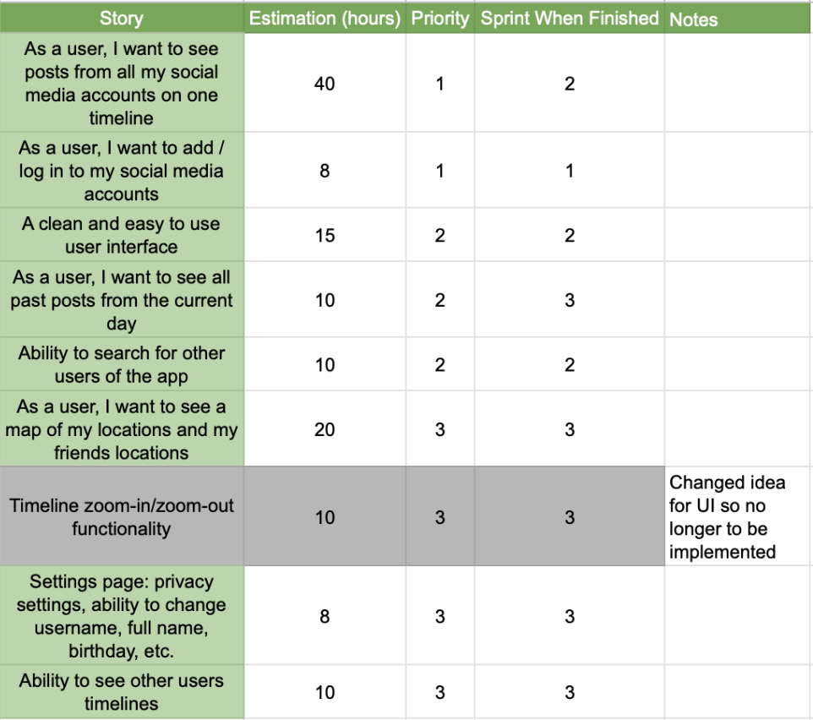
Project Backlog

Slide 6
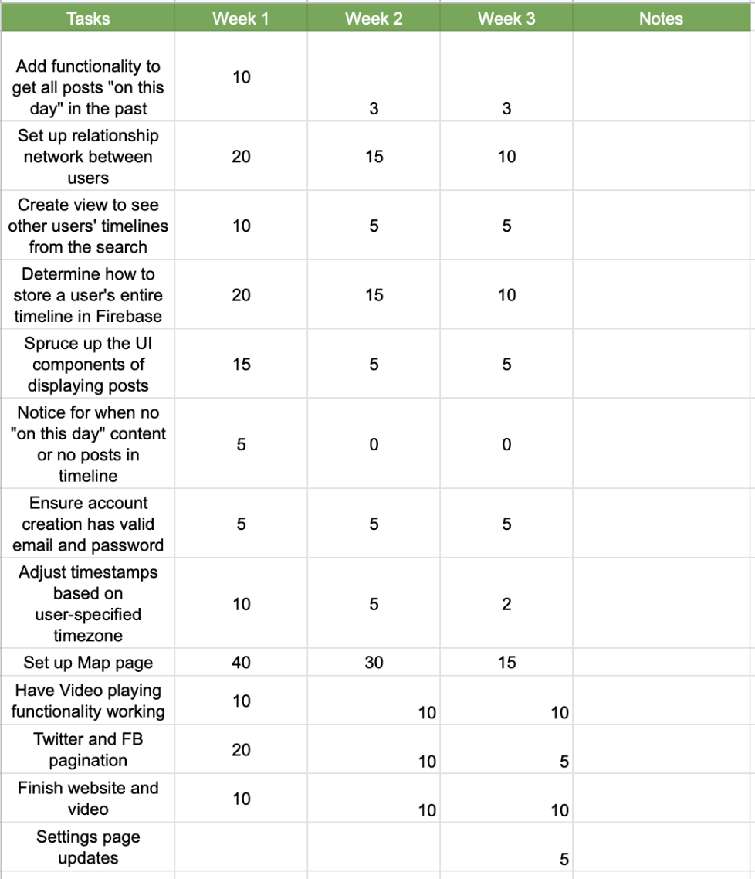
Sprint Backlog

Slide 7
Not Completed/Lessons Learned
Not Completed
The possibility of loading your current friends network posts into on this day due to social media API shortcomings
We did not complete a privacy section
Lessons Learned
UI can be a bit tricky
A friends network can be very complex
It’s easy to go over your API rate limit with a free account

Slide 8
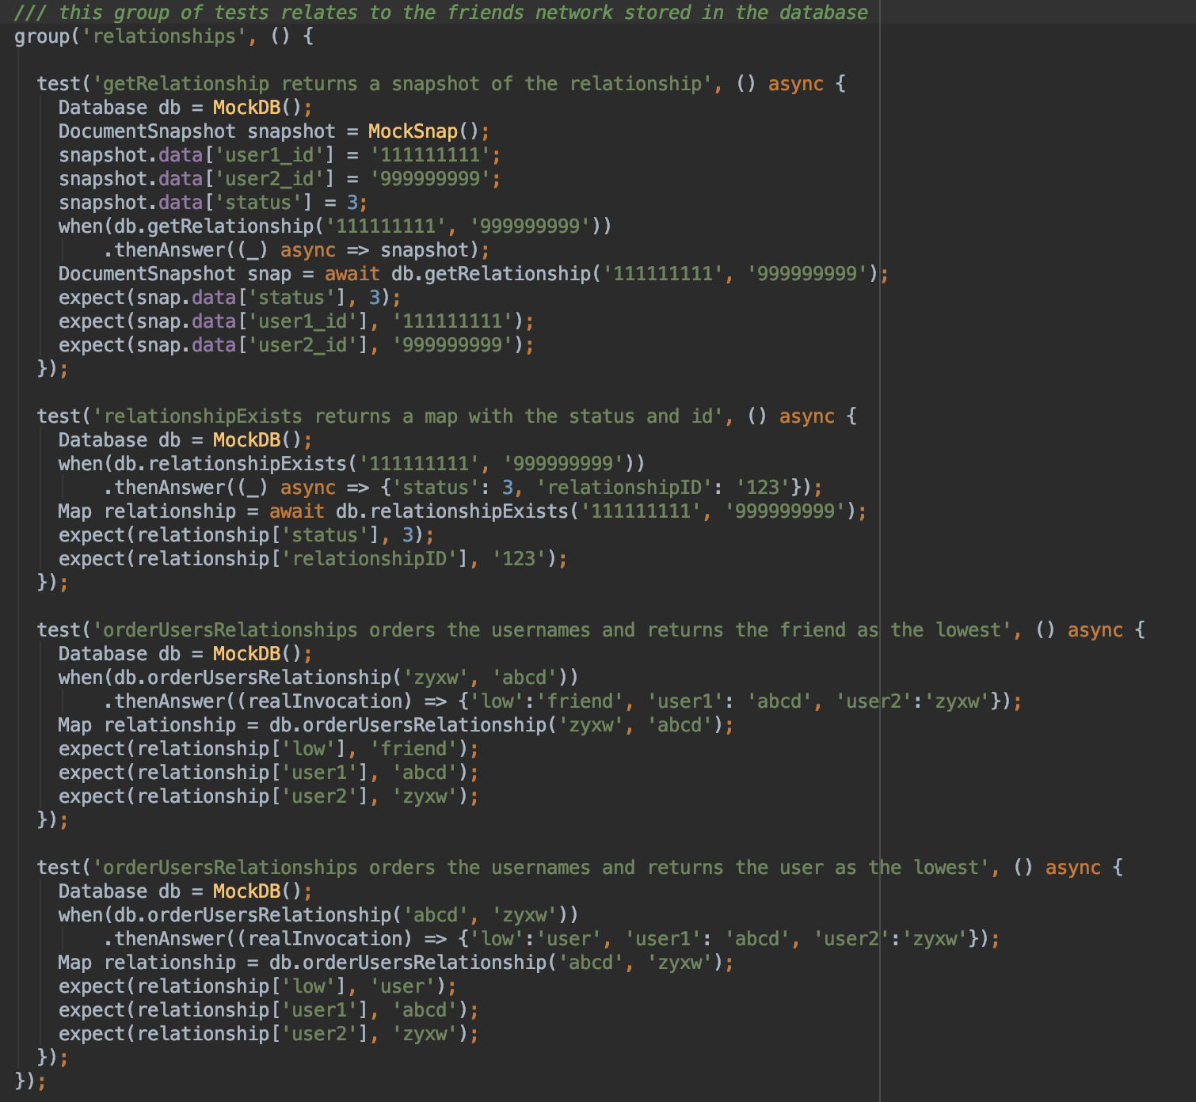
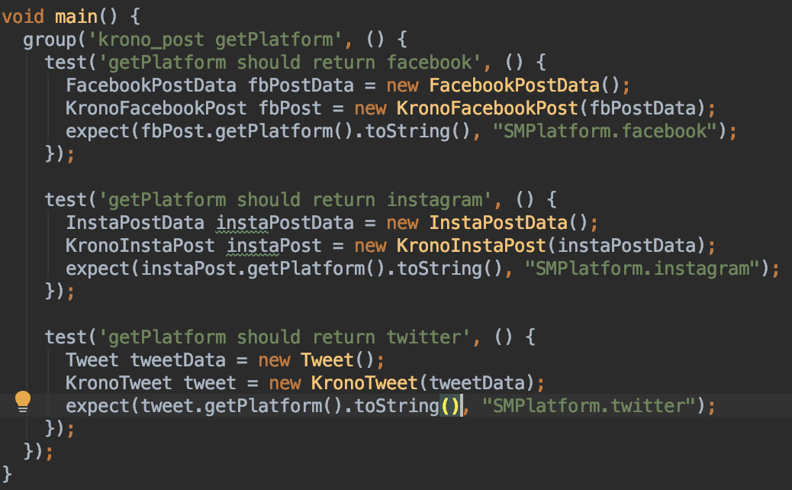
Test Cases

Slide 9
Demo

